Slide 1

TBD
Credit Card Fraud Detection with Python & Machine Learning - Draft
July 2023

Slide 2
AGENDA
1
OUR UNDERSTANDING & SCOPE
OUR APPROACH
PROJECT ARTIFACTS
MODELING & EVALUATION
OUR CONCLUSION
Q&A
3
2
4
3
5
4
6
5
7
6
8

Slide 3

OUR UNDERSTANDING & SCOPE
Our Business Objective and the problem we’re here to resolve
Key Elements
Project Context: Apply Supervised Machine Learning process to a business problem
Reason for selected topic: Assuming fraudulent pattern can be learned from an analysis of past transactions
Business Problem: Using credit card past transactions data, can we spot potential fraud? This would be useful because we could create a classifier that indicates whether a requested transaction is fraud.
Our Goal: Demonstrate problem can be resolved with a supervised ML process with Python
Our Delivery: Generate insight for decision-making & advise on best classifier

Slide 4
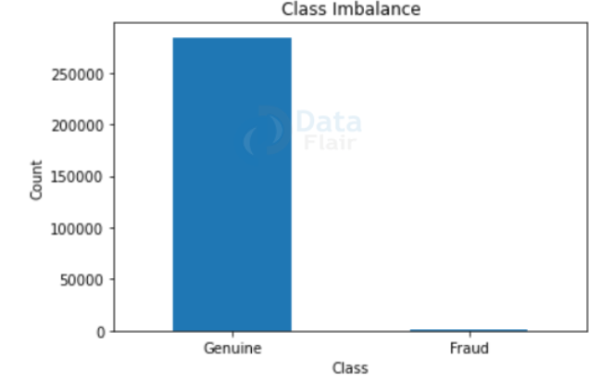
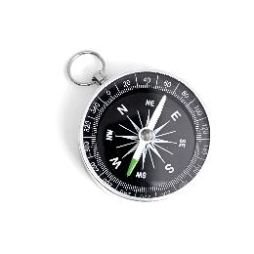

OUR APPROACH
Delivery Methodology for Building the Classifier
1
Perform Exploratory Data Analysis (EDA) on our dataset
Genuine transactions are over 99% - Presence of Class Imbalance – Applied some scaling techniques for amt values transformation.
2
Apply Machine Learning Algorithm to Credit Card Dataset
Built Decision Tree and Random Forest Classifiers to see which one works best. Addressed class imbalance by picking best-performed model - Baseline model: Decision Tree
3
Train and Evaluate our Models
Random Forest best model with a slightly edge over our baseline classifier. Elements of comparison: Classifiers scores, metrics like accuracy, precision, recall, f1-score, confusion matrix
4
Address the Class-Imbalance Issues – SMOTE or Resampling Techniques

Slide 5
PROJECT ARTIFACTS
Solving the problem using a series of Python Libraries or Frameworks.
DATA
TOOLS & LIBRARIES
Pre-trained data imported from Kaggle
Data Source
Python
NumPy
BINARY CLASSIFICATION DATASET
Class 0 – Genuine transactions
Class 1 - Fraudulent transactions
Data Type
Scikit-learn
Matplotlib
Data Consists Of
Parameters: 31
Transactions: 284,807
Fraud: 492
Dataset
Imblearn
Collection, Itertools

Slide 6
MODELING & EVALUATION
TBD – Display some metrics & Visualization in a comparative analysis of DT, RF classifiers and Random Oversampling or SMOTE techniques
Notes:
TBD – use of resampling technique, semi-supervised ML as our model performed much better than our previous Random Forest classifier without oversampling.
In Random oversampling results with Imblearn, we see that we have recall and precision scores of 0.99 and 1.00, respectively. We are catching all fraud transactions.
In SMOTE technique, we have recall and precision scores of 0.99 and 0.98, respectively. We are catching 98% of all fraud transactions.

Slide 7
OUR CONCLUSION
What’s Next?
GitHub Repository
Final Jupyter Notebook
Final Presentation
Topic is utmost important for banks and Financial organizations
For consumers: to stop being bill for goods they haven’t purchased
Problem solved: Detecting credit card fraud transactions using machine NumPy, scikit learn, and few other python libraries.
Best-fit Classifier still requires to resolve the class-imbalance issue
Random Forest and Random oversampling (Resampling) as best models

Slide 8
Q & A

